Slide 1
Discord SET Bot Midterm Project Report
Alex Algazi asa10@hood.edu
4/4/22

Slide 2
What is Discord?
VoIP and instant messaging platform released in May of 2015
Users congregate in communities called guilds, or “servers”
Includes an extensive API for developing bots for the platform
The capabilities of bots range from simple call-and-response text messaging to bots that facilitate music streaming into voice channels
Initially popular among video game enthusiasts, Discord is now regarded as an all-purpose communication platform by many millennials and Gen Z-ers

Slide 3
What is SET?
Pattern-recognition card game invented by geneticist Marsha Falco in 1974
Each card has four attributes: number, shading, color, and shape
There are three possibilities for each attribute:
Number: One, Two, Three
Shading: Solid, Striped, Open
Color: Red, Green, Blue
Shape: Oval, Squiggle, Diamond
There are 81 cards in the deck, one for each possible combination (3⁴)
A set is a group of three cards where each attribute is either the same for all three cards OR different for all three cards
Players compete to find sets on a face-up group of cards called a board

Slide 4
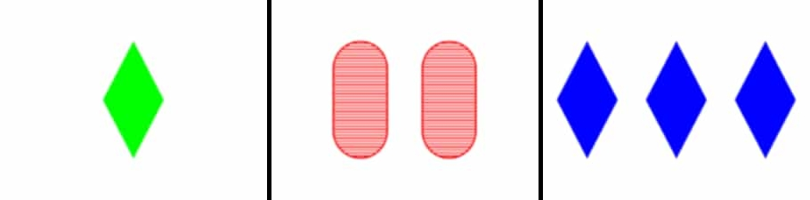

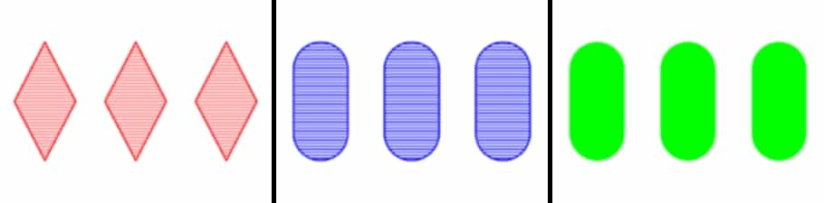


Slide 8
Objectives
Generate a board of 12 cards face-up, such that all users in a guild can see
Recognize a correct 3-card set using arithmetic
Systematically check a board for sets, and add 3 cards if no set is found
Take user inputs using Discord emoji reactions
Regenerate the board after a set is found, such that the board always has at least 12 cards
Show user scores in an ordered leaderboard when the game ends
Track relevant statistics in each guild so users can review their performance alongside other users in their guild

Slide 9
Background
Bots have existed on the platform since December 2015, when Discord launched their unofficial API
Common use cases for bots at that time included an early music streaming bot, a dice-rolling bot, and bot which scans the internet for funny images
In recent years, bots have been made for all sorts of purposes, including games. Notable examples of game bots include:
Pokétwo - a bot that emulates the experience of playing a Pokémon game
EPIC RPG - a bot which guides users through a role-playing game with dungeons, an in-game economy, and player-versus-player interactions
AniGame - a collectible card game where users can assemble teams of fighters to fight through randomly generated dungeons, or battle it out against other players
Gamebot - a collection of games for Discord guilds, including Chess, Connect 4, Cards Against Humanity, and various others
However, no one has ever attempted to make a bot for the SET card game…

Slide 10
Project Plan
Create a logic loop that will enable the game to be played until there are no cards remaining in the deck
Encode the cards such that proposed sets can be checked mathematically
Stitch images of the cards together to assemble randomly generated rows
Use reaction collectors to record user inputs, and run set-checking on each user’s last 3 selected cards
Check the board for sets in an efficient manner
Store game data in a JSON file that can be accessed at any point
Send game data to a database for later retrieval
Host the bot on Hood’s “pluto” server

Slide 11
Tech Stack
JavaScript, for the game logic
Node.js, a server-side JavaScript runtime environment
Discord.js, a Node framework for using Discord API calls
SQLite, to store game data as well as player scores in a discrete file
pluto@hood.edu, as a host for the bot and all its data
Required Functionality/Features
“/newgame” command will start the game, generating a new random board
Players will be able to select cards from the board, and when a set is found, a new board will be generated with the 3 selected cards replaced
Play will continue until the deck is empty and there are no sets left on the board, or until the user who started the game presses the cancel button
Scores will be displayed, and stats will be recorded about each game when they end or are cancelled

Slide 12
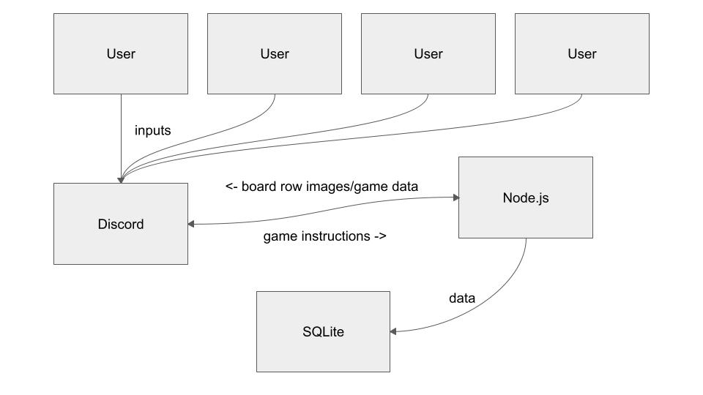
Architecture

Slide 13
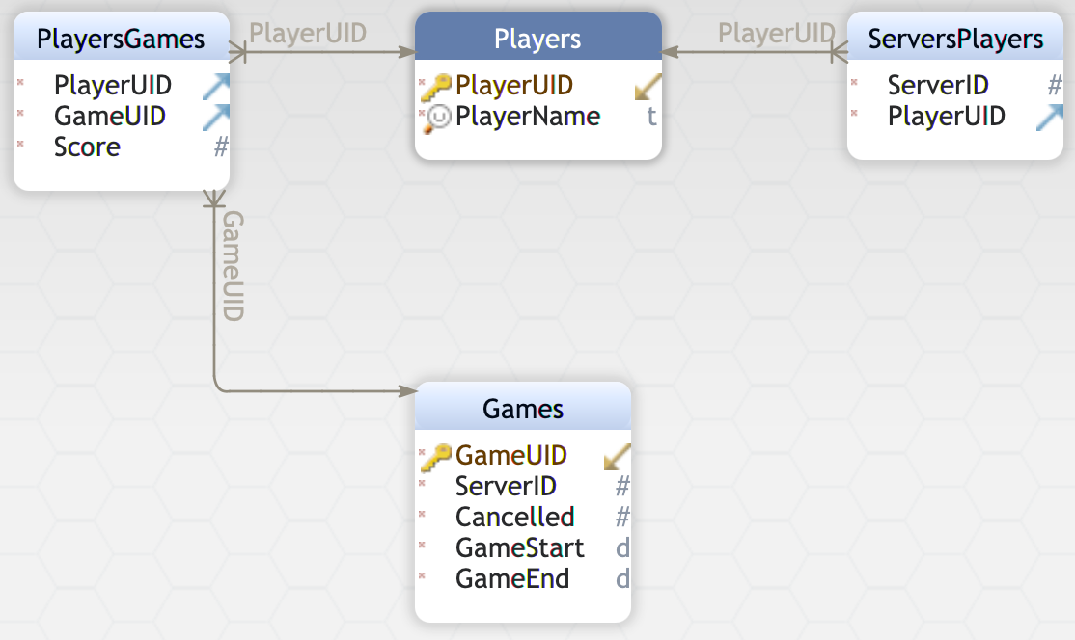
Database Structure

Slide 14
Accomplished Work
Besides database integration and statistics, all functionalities described in this document have been successfully implemented
Game loop is achieved through recursion of the “continueGame()” method
Cards are encoded using four digits, with values 1 2 and 3 for card properties
Images are composited using images.js, a Node.js framework for manipulating image files
Six identical reaction collectors have been made, one for each possible row
Boards are checked using an optimum pair-check algorithm as described in the paper “On the Complexity of the Game of SET,” by K. Chaudhuri et al.
The bot has yet to be hosted on pluto@hood.edu, but we have developed a Unix service file that will allow for uninterrupted operation of the program
The main logic file, “newgame.js”, contains over 1000 lines of code
The project is absolutely living up to our initial expectations, and in some cases even exceeding them

Slide 15
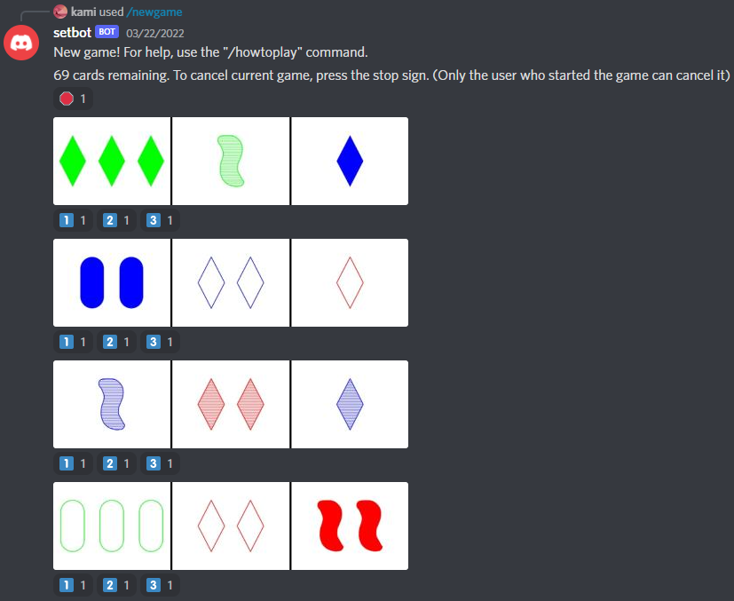
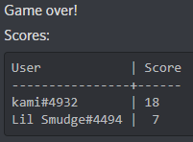

Slide 16
Effort
Team Member Name | Responsibilities/ Accomplishments | Hours Spent
Alex Algazi | Game loop structure General encoding Image generation Game data storage Unix service | 25
Diana Teka | Board set-checker Player scores display Help command “/howtoplay” Database structure | 18

Slide 17
Effort cont.
The team communicated using Discord primarily, and using email when the other member could not be reached on Discord
We used clockify to record the number of hours worked on each task
We used Jira to track our overall schedule and keep track of individual tasks
Overall, this style of communication (using Discord) was very effective, and we were able to meet and work on the project remotely using Discord’s VoIP calls
My only regret is that I wish we could have used the time in class more efficiently. Since the bot only has one unique ID, only one person could be testing features at a time, which slowed down development in some instances.

Slide 18
Lessons Learned
When you have a development environment with only one user permitted to test at a time, responsibilities must be delegated such that one team member can always be working on something, such as the database backend, that does not require immediate testing.
Much of our time in late February/early March was spent redesigning the overall structure of the program to account for a timing discrepancy in the generation of the board’s elements. In retrospect, being first-time discord developers, we could not have foreseen this complication. However, in the future, were I to develop another Discord application, I would try to better account for processing overhead from the beginning, rather than having to patch it up later.

Slide 19
What’s Next?
While the database schema has been finalized, we still need to include logic for inserting records into our tables in the program. This will be accomplished by Tuesday April 26th
After that, we need to finally migrate the bot over to pluto@hood.edu, in such a way that the program will be automatically executed at runtime on the server. This will be completed by the final deliverable date, Tuesday May 5th

Slide 20
In loving memory of Diana Teka

